Slide 1

(Beijing, China) November 23th- 25th 2021
International Workshop on the
Integrated Use of International
Trade Statistics and Economic Statistics
TEC data production, preparation for STEC data production
Maria Serena Causo (causo@istat.it), Mirella Morrone (mimorron@istat.it), Adele Vendetti (vendetti@istat.it)
Division for Statistics on production and foreign trade - Istat, Italy

Slide 2
Main contents
Overview
Measuring trade in goods by traders – the EU approach
TEC – Trade by Enterprise Characteristics
STEC - Service Trade by Enterprise Characteristics
UN workshop with China on Trade in Goods and Services
(Beijing, China) November 23th- 25th 2021

Slide 3
Measuring trade in goods by traders in the ESS
Data sources:
            Extra-EU trade Customs administrative data
Intra-EU trade - Statistical survey (eventually joined with fiscal
            administrative obligations)
            - Estimates for missing trade (out-of-sample and
            late responses) based on fiscal data
UN workshop with China on Trade in Goods and Services
(Beijing, China) November 23th- 25th 2021

Slide 4
Extra-EU Trade - Framework
    Use of customs declarations data for compilation of Extra-EU trade statistics
The legal requirement and specifications for providing a customs declaration are laid down in the European customs provisions. The customs declaration has to be provided by the declarant, being the person liable for respecting the customs formalities and rules.
Statistical declaration and statistical data. The statistical declaration is not foreseen under Union legislation on extra-EU trade statistics nor is there any obligation for traders to provide such a declaration. The statistical data are collected through the relevant data on the customs declaration (e.g. goods code according to the CN) or of purely statistical relevance (e.g. nature of transaction).
Data collection process — standard customs declaration transmitted from Customs to NSAs. National Customs are required to provide NSAs customs declarations lodged with them at the latest the month following the month of acceptance.
UN workshop with China on Trade in Goods and Services
(Beijing, China) November 23th- 25th 2021

Slide 5
Extra-EU Trade – Traders’ identification
  EXTRASTAT REGISTER (EORI)
  Specific obligations for customs authorities to provide traders’ identification numbers (trader-ID) to National Statistical Administrations was introduced by Regulation (EC) No 471/2009 in 2010
  Maintaining a register of extra-EU trade operators is essential to be able to contact traders and extremely useful for analytical, validation and estimation purposes
  Key element to compile Trade by Enterprise Characteristics based on linking trade information at trader level with the statistical business register
  The identification of traders for customs purposes has been harmonised at EU level and ID system, namely the Economic Operators Registration and Identification (EORI) system was introduced in mid-2009.
UN workshop with China on Trade in Goods and Services
(Beijing, China) November 23th- 25th 2021

Slide 6
Extra-EU Trade – Which kind of traders?
UN workshop with China on Trade in Goods and Services
(Beijing, China) November 23th- 25th 2021

Slide 7
Intra-EU Trade - Framework
    Direct data collection from economic operators
The main data source for the collection of intra-Union trade statistics is statistical survey. Member States collect monthly data from reporting units involved in intra-Union trade. EU regulation set minimum traded value coverage for the statistical (in 2021 97% for export and 93% for import, in 2022 95% for export and no minimum coverage for imports). In order to minimize statistical burden, a cut-off sample based on exemption thresholds is selected in such a way to meet the minimum coverage requirement.
Missing trade, i.e. trade for traders below the exemption thresholds, is estimated from administrative data sources
UN workshop with China on Trade in Goods and Services
(Beijing, China) November 23th- 25th 2021

Slide 8
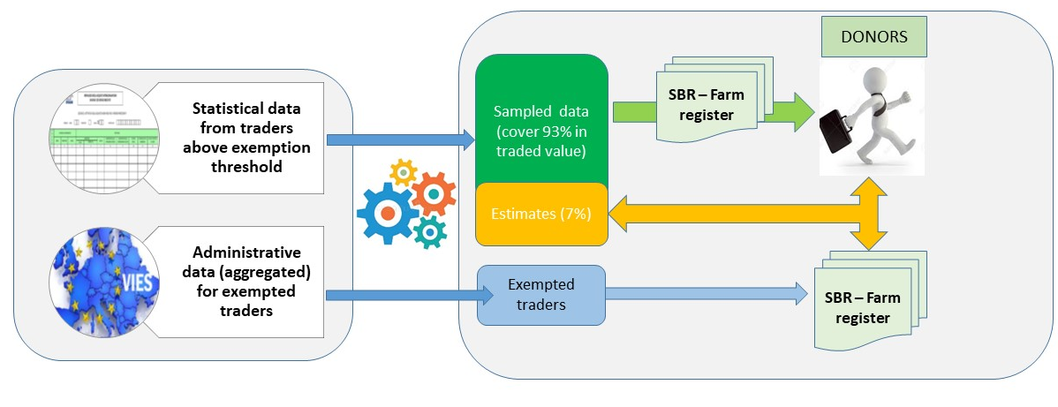
Intra-EU trade statistics compilation process overview
Data Sources
Statistical process
UN workshop with China on Trade in Goods and Services
(Beijing, China) November 23th- 25th 2021

Slide 9
Intra-EU Traders population
Intra-EU Traders population is the set of traders who makes taxable supplies or acquisitions in a Member State
Resident traders
Non-resident traders with no place of business in the Member State
Traders supplying or selling goods in Member States other than the one in which they are established must register for VAT purposes in that Member State.
Non-resident traders have the same obligations as resident traders. In the case of intra-Union supplies or acquisitions, they have to provide national tax administrations with VAT returns and to submit statistical declarations.
Tax groups. Two or more companies or limited liability partnerships may register as a single taxable person — or VAT group — if they meet the following criteria:
- each body has its principal or registered office in the reporting Member State;
- they are closely bound to one another by financial, economic and organisational links.
UN workshop with China on Trade in Goods and Services
(Beijing, China) November 23th- 25th 2021

Slide 10
Register of Intra-EU reporting units
The essential function of the register is the maintenance of an up-to-date list of intra-Union operators with their company identification data. This information is based on fiscal data and is used:
to identify companies who may be required to provide statistical declarations;
to ensure the timely collection of statistical information;
for quality checks and data analysis;
for estimates of the trade of non-reporting units, partial and non-response;
for compiling Trade by Enterprise Characteristics by linking trade information at trader level with the statistical business register.
UN workshop with China on Trade in Goods and Services
(Beijing, China) November 23th- 25th 2021

Slide 11
TEC data compilation
  The use of TEC data for the analysis and assessment of Member States' economies is increasing every year. It is necessary to meet the users needs by providing accessible, relevant and timely information.
Scope
  The main objective of the Trade in goods statistics by Enterprise Characteristics (TEC) is to bridge two major statistical domains which have traditionally been compiled and used separately, business statistics and international trade in goods statistics (ITGS). The SBRs play an important role in the compilation process of business statistics.
UN workshop with China on Trade in Goods and Services
(Beijing, China) November 23th- 25th 2021

Slide 12
Key facts about SBR
  Business registers for statistical purposes allow:
  The detection and construction of statistical units. The units used for statistical observation or analysis may represent real economic structures but do not always correspond to legal or administrative units. The role of the SBRs is to function as a bridge between administrative and statistical units
  The preparation and coordination of surveys and for grossing-up survey results. The most obvious use for SBRs is to supply sample and population data necessary for conducting surveys
  Providing statistics and analysis of business population and its demography. Number of enterprises, employment, turnover and business demography changes of the enterprises (births, deaths, survival and growth), breakdown according to institutional sectors are provided within SBR
  Providing tool for using administrative data for statistical purposes. The use of administrative data in the production of statistics has gained relevance to decrease burden on enterprises
  Integration of statistical data from different statistical authorities.
UN workshop with China on Trade in Goods and Services
(Beijing, China) November 23th- 25th 2021

Slide 13
Methodological aspects about Trade – SBRs data integration
VAT code represents the key between Foreign Trade Register and SBRs
Each trader VAT code (Legal Unit) can be associated to a Business Unit code (Statistical Unit)
Link between VAT [ID] BU [ID] based on:
The Statistical Business Register system
Historical Revenue Agency Register
Integration process: step 1
The traders VAT Register [VAT and EORI numbers] is linked with SBRs system (through the complete VAT Register)
Link with the enterprise demography dataset units (business register of the legal unit events)
Complex Units: Analysis of enterprises that are suspected to be Special Purpose Entities (VAT that are not relevant “statistical unit”, but with high values and belonging to a group)
UN workshop with China on Trade in Goods and Services
Beijing, China, November 23th- 25th 2021

Slide 14
Methodological aspects and integration issues
Linking trade values with enterprise characteristics: step 2
The trade data of each trader are linked with the enterprise characteristics recorded in the SBRs
UN workshop with China on Trade in Goods and Services
Beijing, China, November 23th- 25th 2021

Slide 15
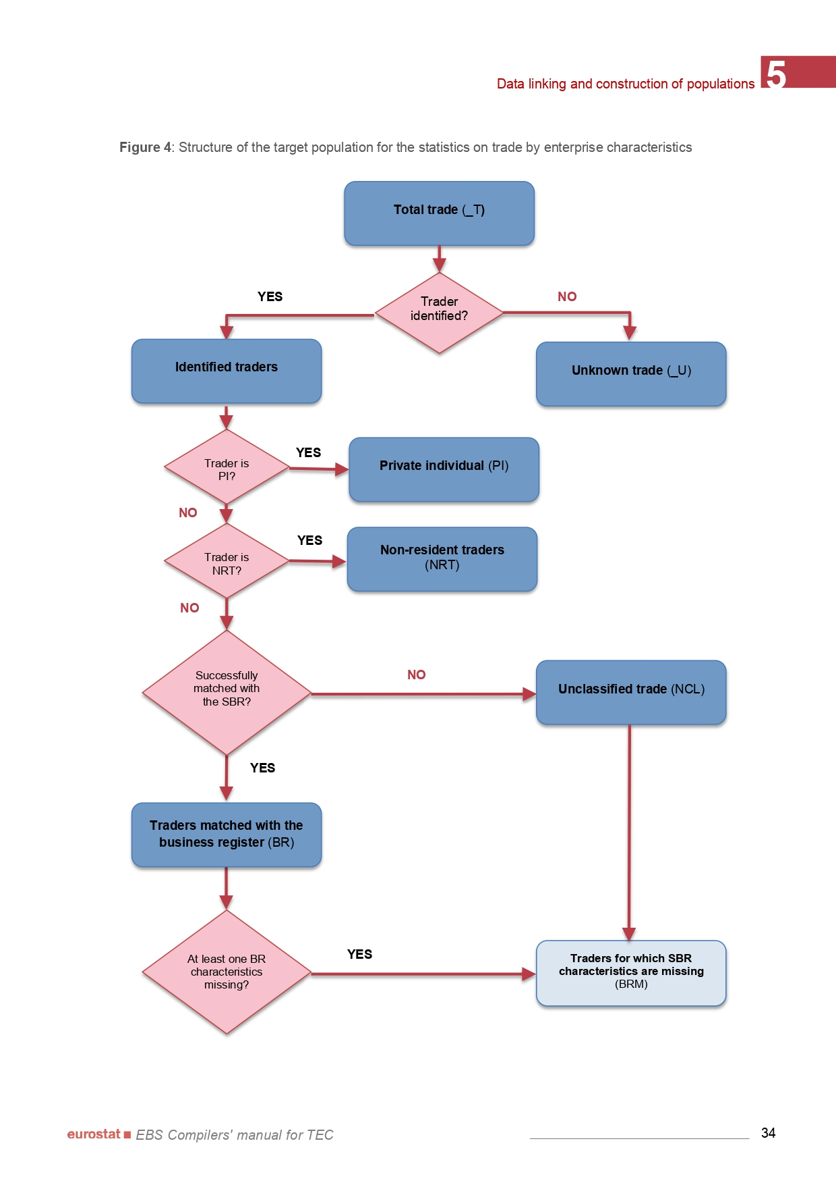
Classifying type of traders
UN workshop with China on Trade in Goods and Services
(Beijing, China) November 23th- 25th 2021

Slide 16
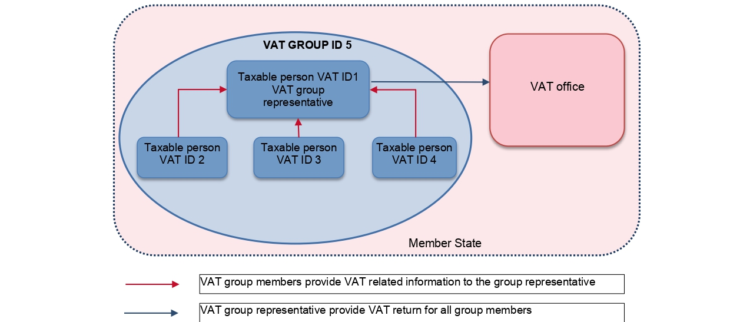
Further refinements: Treatment of VAT GROUPS
VAT groups are a fiscal simplification for enterprises VAT reporting.
The TEC compilers can establish a link between the VAT group and its legal units using fiscal VAT groups registers and adopt suitable methodologies to allocate VAT group trade transactions by enterprises belonging to the group.
UN workshop with China on Trade in Goods and Services
(Beijing, China) November 23th- 25th 2021

Slide 17
ISTAT RECENT IMPROVEMENTS AND FORTHCOMING DEVELOPMENTS
Recent improvements
Improved coverage using additional registers: farm register, register of public institutions, register of nonprofit institutions
Forthcoming developments
Deploying the new statistical unit "ENT" from reference year 2021
Increasing timeliness: with the implementation of the European Business Statistics (EBS) Regulation, the TEC data will have to be compiled and provided to Eurostat earlier (at T+12 months). This deadline will be applicable from 2023 (2022 data)
Assuring consistency with Structural Business Statistics (SBS) data, with particular focus on enterprises for which export value > turnover;
UN workshop with China on Trade in Goods and Services
(Beijing, China) November 23th- 25th 2021

Slide 18
STEC Statistics: Scope and definition
Scope: measuring the changing of the economy
Increasing demand of harmonized, reliable and timely services sector statistics, which are able to:
measuring the structure and dynamics of production and international trade of services according to the nature of services´ traders in the European Union
better analyzing emerging phenomena by using data across statistical domains (e.g. GVC) while developing more sophisticated economic analyses
UN workshop with China on Trade in Goods and Services
(Beijing, China) November 23th- 25th 2021

Slide 19
STEC Statistics: Scope and definition
Definition
No simple definition of services: cover a heterogeneous range of intangible products and activities, often are used abstract concepts rather than identifying any specific physical attribute or physical function.
“Services are the result of a production activity that changes the conditions of the consuming units or facilitate the exchange of products or financial assets” (SNA 2008)
UN workshop with China on Trade in Goods and Services
(Beijing, China) November 23th- 25th 2021

Slide 20
STEC Statistics: Legal framework
EU Regulatory Framework: European Business Statistics (EBS)
Regulation (EU) 2019/2152 of the European parliament and of the Council on European business statistics repealing 10 legal acts in the field of business statistics
Commission Implementing Regulation (EU) 2020/1197 laying down technical specifications and arrangements pursuant to Regulation (EU) 2019/2152
New EBS regulatory framework entails the inclusion of statistics on foreign trade in services within the business statistics changing the observation angle of the phenomenon from product-based to the companies involved in the international trade in services and the ways in which these services are provided.
UN workshop with China on Trade in Goods and Services
(Beijing, China) November 23th- 25th 2021

Slide 21
STEC tables to be reported and transmission deadline
Statistical value of imports and exports of services by enterprises
Breakdown | First reference year | Data transmission deadline
1, 2, 3 | 2022 | T+18 months = June 2024
STEC by activity and size class of number of employees and self-employed persons [World; Intra-Union; Extra-Union]
STEC by activity, type of product and additional geographical breakdown
STEC by activity and type of control [World; Intra-Union; Extra-Union]
Activity → Statistical Classification of Economic Activities in the European Community (NACE)
Product → Extended Balance of Payments Services Classification (EBOPS 2010)
UN workshop with China on Trade in Goods and Services
Beijing, China, November 23th- 25th 2021

Slide 22
Production of International trade in services statistics in Italy
Statistics on international trade in services (ITSS) are produced from the transactions recorded under a country’s Balance of Payments (BoP), which capture all transactions that take place between an economy’s residents and non-residents, namely monetary value of import and export of services by type of service and by partner country.
→ Bank of Italy is responsible for the production of ITSS
Country-level business statistics on trade in services by enterprise characteristics (STEC) will be produced under the EBS Regulation by breaking down traditional services trade statistics according to specific enterprise characteristics namely activity sector, size class and type of ownership of the enterprise.
→ Istat - the National Institute of Statistics is responsible for the production of STEC
UN workshop with China on Trade in Goods and Services
Beijing, China, November 23th- 25th 2021

Slide 23
Production of International trade in services statistics in Italy
Close Cooperation between Bank of Italy and Istat in the data production process in order to ensure data quality and information consistency between ITSS and STEC
A permanent Committee ensures coordination on statistical matters between BI and Istat
The production system implies a large combination of statistical information stemming from different data sources, that entails:
  intensification of micro-data exchanges between the two Institutes
  sharing of methodological and technical skills
  further development on data sources (statistical and administrative data)
Guarantee the sustainability of the system: legal framework and technical arrangements between the two institutions involved (e.g. suitable IT tools, etc.)
UN workshop with China on Trade in Goods and Services
Beijing, China, November 23th- 25th 2021

Slide 24
Development of STEC in Italy: an integrated approach - MDL
STEC data will be compiled by linking existing official data sources at enterprise level:
trade in services micro-data collected as part of the ITSS → Bank of Italy
data profiling the businesses derived from the Statistical Business Register (SBRs) and other SBS → Istat
ITS survey
Statistical Business Registers *
Inward/Outward FATS, SBS…
Administrative sources (e.g. Intrastat Services, VAT declaration, VIES)
Fiscal [ID]
Fiscal [ID]
VAT [ID]
VAT [ID]
BU [ID]
BU [ID]
Services import/ export by EBOPS and partner country
Economic activity; size class
(n. of employees);
Type of ownership;
Turnover; Purchase
*Business Register (BR) (Industry & Services), Enterprises Register & Groups Register,
Farm Register, Registers of public institutions and of nonprofit Institutions
UN workshop with China on Trade in Goods and Services
Beijing, China, November 23th- 25th 2021

Slide 25
STEC breakdowns to be implemented
Product breakdown by EBOPS 2010 main components
Manufacturing services on physical inputs owned by others
Maintenance and repair services, not included elsewhere
Transport
Travel
Construction
Insurance and pension services
Financial services
Charges for the use of intellectual property, not included elsewhere
Telecommunications, computer and information services
Other business services
Personal, cultural and recreational services
Government goods and services, not included elsewhere
ITSS
UN workshop with China on Trade in Goods and Services
Beijing, China, November 23th- 25th 2021

Slide 26
STEC breakdowns to be implemented
Activity breakdown according to NACE classification
NACE Sections: C, F, G, H, J, K, M, N
Aggregates of NACE Sections: (A+B, D+E, I+L+O+P+Q+R+S+T+U)
Business Register
Farm Register
Enterprises Register
Breakdown of Size class of the enterprise according to Number of employees
- Small: 0 _49
  further disaggregated into
  - 0_9
  - 10_49
- Medium: 50_249
- Large: 250 or more
Breakdown of type of control
- Domestically controlled enterprises
  further disaggregated into:
  - Domestically controlled enterprises without own affiliates abroad
  - Domestically controlled enterprises with own affiliates abroad
- Foreign-controlled enterprises → UCI country
Inward/Outward FATS
Enterprise Groups Register
UN workshop with China on Trade in Goods and Services
Beijing, China, November 23th- 25th 2021

Slide 27
Development of STEC in Italy: an integrated approach
Currently ITS sample design is built to satisfy BoP requirements, no STEC characteristics (i.e. activity, size and type of control) are taken into account nor it is based on SBR
The collection and compilation system adopted in Italy is a multi-source system.
Most of the ITSS data are collected through enterprise surveys and administrative records for the main EBOPS 2010 items.
In addition, statistical models are used for some services items (e.g. manufacturing services on physical inputs owned by others; transport; travel; insurance and pension services and financial services). Travel also uses persons and households surveys.
The representative sample includes non-financial companies and insurance companies. Stratification of the sample is based on entities involved in cross-border transactions and according their turnover. Enterprises are selected according to a cut-off approach.
UN workshop with China on Trade in Goods and Services
Beijing, China, November 23th- 25th 2021

Slide 28
Development of STEC in Italy: an integrated approach - MDL
Total ITS
ITS survey
Not linkable trade (e.g. Travel, FISIM, Gross up figures, etc.)
Yes
Valid Fiscal ID
No
Mismatches mainly due to:
Intra-annual business demography changes
Large and complex businesses
Incomplete business register
Unknown trade
linked
with BR
No
Unclassified trade
Yes
Total trade successfully matched with SBR
Total STEC
UN workshop with China on Trade in Goods and Services
Beijing, China, November 23th- 25th 2021

Slide 29
Development of STEC in Italy: an integrated approach - Future steps
Improve the quality and the coverage of STEC statistics
Re-Design ITS sample to satisfy both BoP and STEC requirements by:
Increasing sample size
Changing sample stratification’s criteria: taking into account also STEC characteristics (activity and size)
Making better use of administrative data (e.g. Intra Services data, VAT declarations, VIES) to improve the estimates both:
to better design the sample according information derived from administrative sources (in particular data on Intra-UE services’ transactions)
to distribute the gross up trade on STEC dimensions
The better integrated the approach; the more decreased the unknown trade
UN workshop with China on Trade in Goods and Services
Beijing, China, November 23th- 25th 2021

Slide 30
Thank you!
UN workshop with China on Trade in Goods and Services
Beijing, China, November 23th- 25th 2021

